Slide 1
Learning Green’s Functions – M2R Project
Charlie Lowman, Haochen Gu, Lorenzo di Giura del Balzo di Presenzano, Wanying Qi and Yubo Zhang
18/06/2025

Slide 2
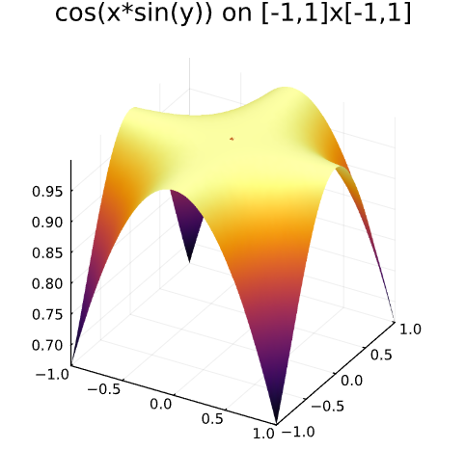
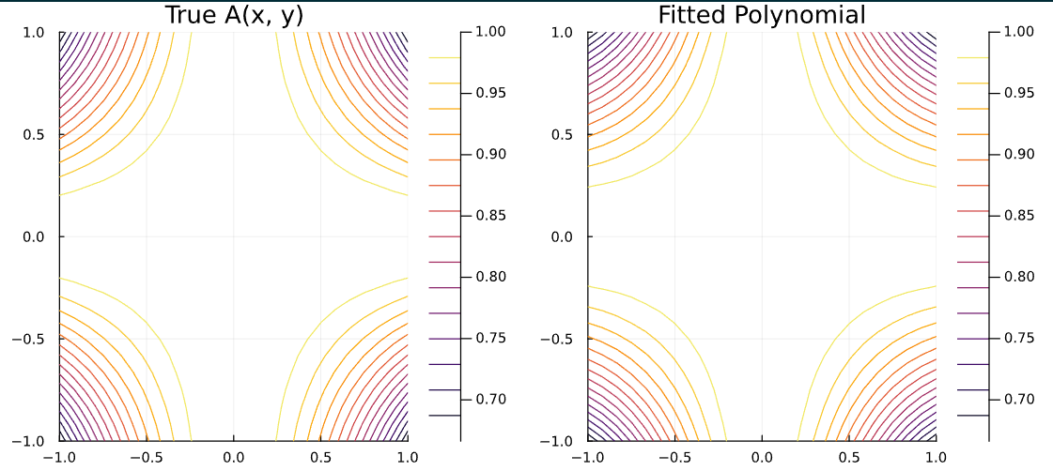
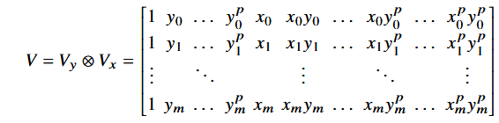
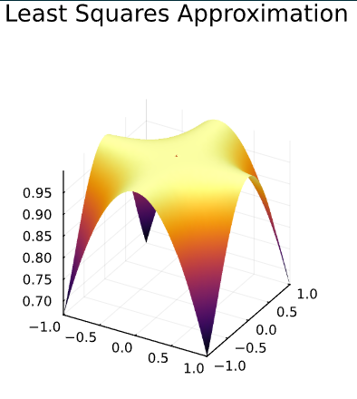
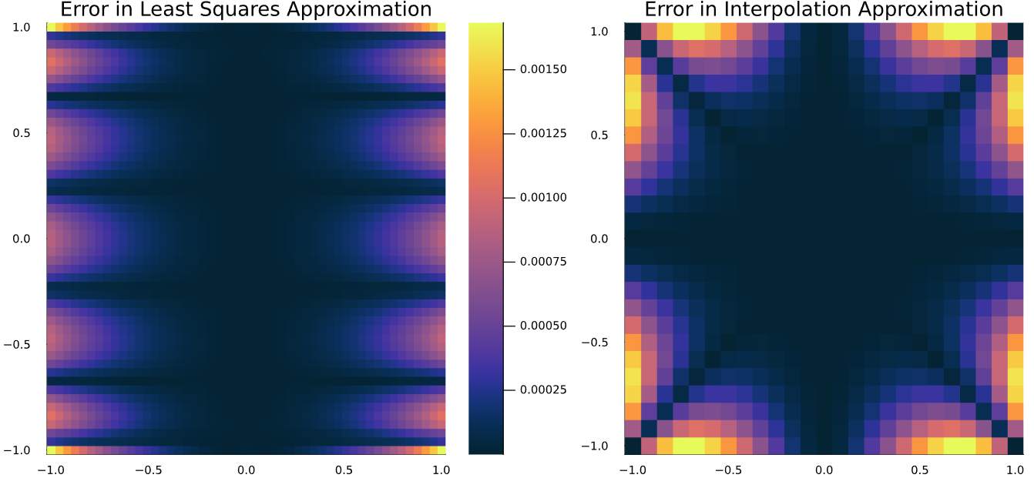
Background – Numerical Methods
Polynomial Interpolation
- Vandermonde Matrices
- Kronecker Product
- Errors and convergence
Least Squares Regression
- Very similar to the above method
- Errors occur in different locations
- Simpler to implement using Julia but less versatile

Slide 3
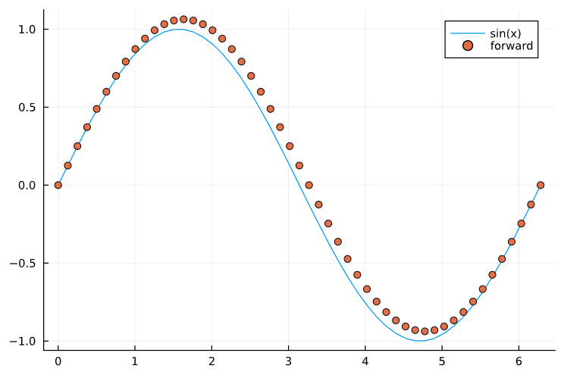
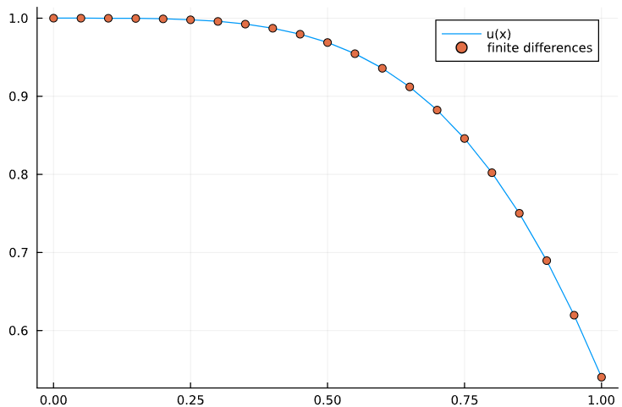
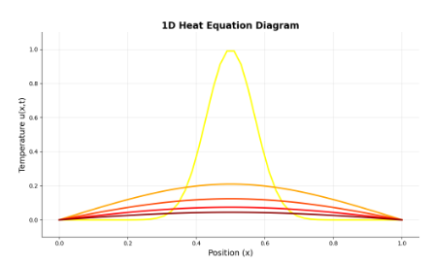
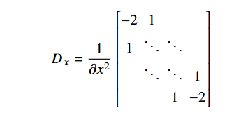
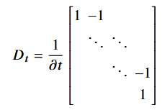
Background – Numerical Methods
Finite Differences
- Numerical solution to differential equations
- Addition of a potential
- Boundary conditions for u = cos(x²)
Heat Equation
- Unforced heat equation
- Two variable heat equation (x and t)
- Vectorise the sampled solution matrix
- Solution using Julia

Slide 4
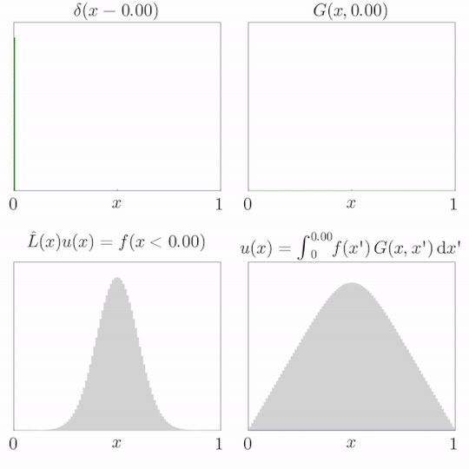
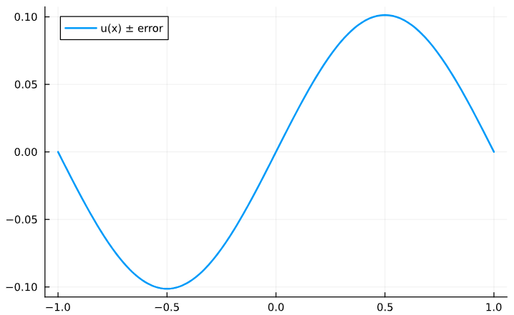
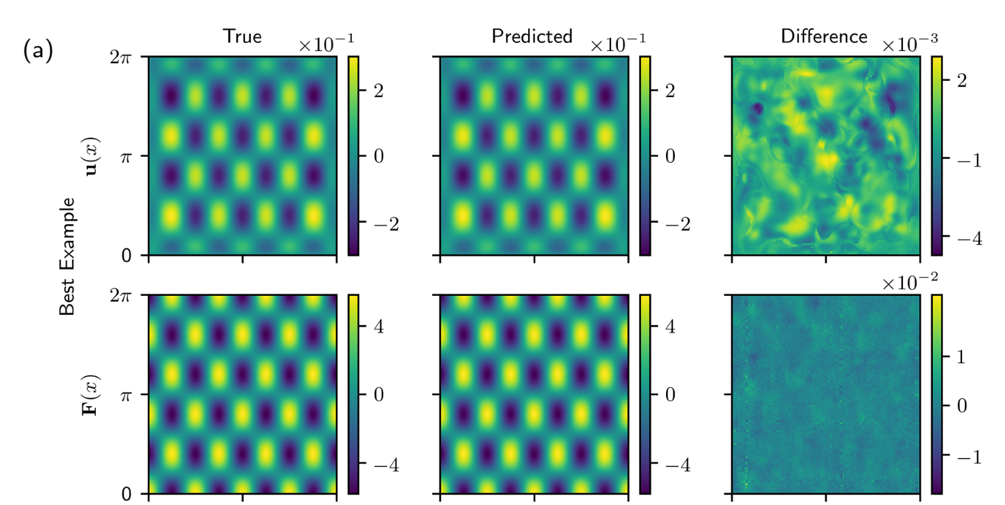
Green’s Functions
Definition
- Fundamental solutions
- Solution to a specific right hand side
- Why the delta function is chosen
Derivation
- Integration of Dirac-delta
- Use of step functions
- Constraints and boundary conditions
- Rarely able to solve analytically
Use in Quadrature
- Used to recover u the solution to the specific problem
- Convolution of the Green’s function and the right hand side over the domain

Slide 5
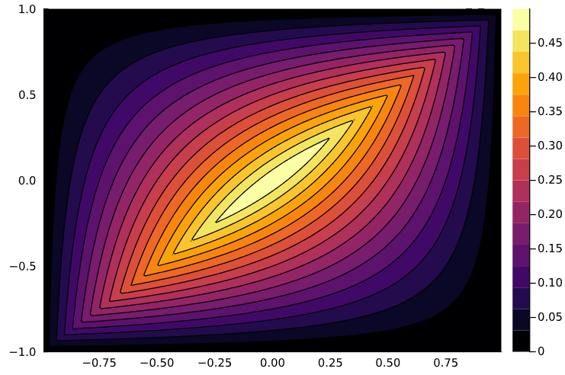
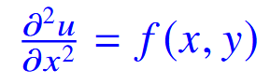
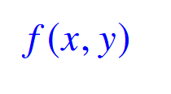
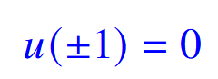
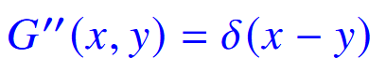
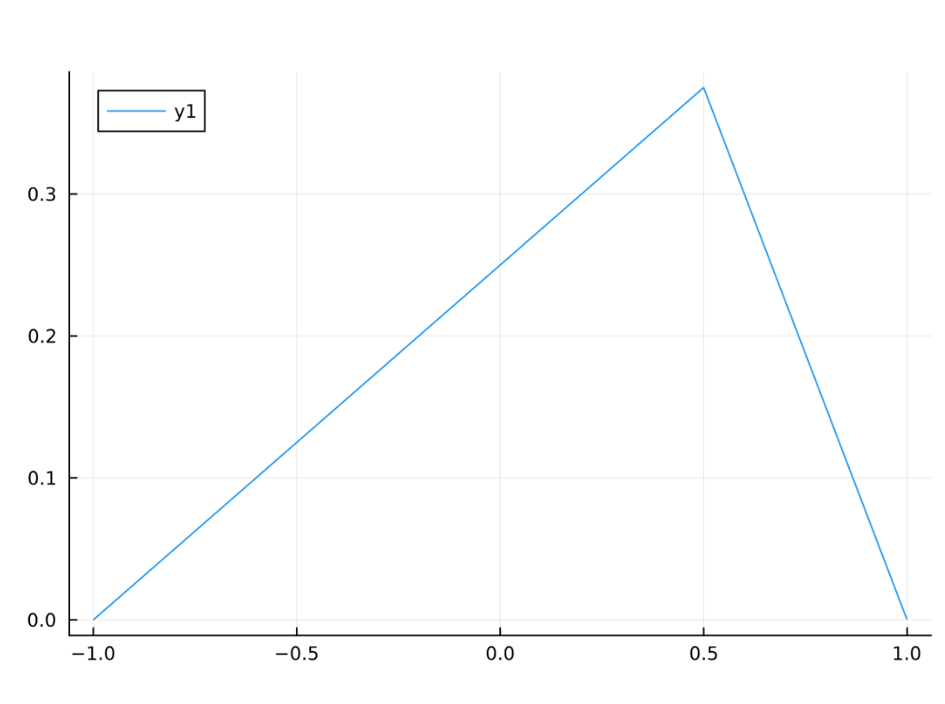
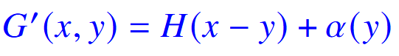
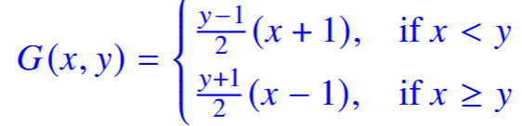
Green’s Functions - Poisson
Derivation of the Green’s Function for the Poisson Equation
- We have the equation , the Poisson equation with initial conditions
- For this example, we take the boundary constraints
- To convert this to a Green’s function problem, we set
- We can integrate this to obtain a step function as well as a constant term, yielding
- Integrating again gives G in terms of ramp and unknown functions, and then we apply the boundary conditions
- We also know the jump discontinuity is 1, and that the function must be continuous at y
- These are enough constraints to give our full function, which in this case turns out to be:
Contour plot for the Green’s function to the Poisson equation
A slice of the above plot for y = 0.5

Slide 6
Numerical Approximations to Green’s functions
Why do we need numerical Green’s functions?
Analytic solutions to the Green’s function are rare
Can solve PDE for any RHS
Complex geometries and Boundary Conditions
We will cover:
Finite Differences → Polynomial Correction → Spectral Methods
Notes:
Most non-constant coefficient or non-standard domain PDEs have no closed-form Green’s function
Once you have G, you can cheaply compute u for any RHS via a single convolution/integral or use quadrature.
Numerical G lets you handle irregular domains, variable coefficients, or mixed boundary conditions.

Slide 7
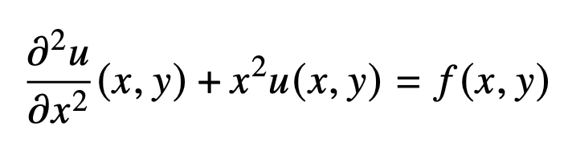
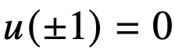
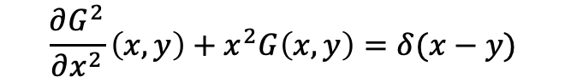
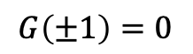
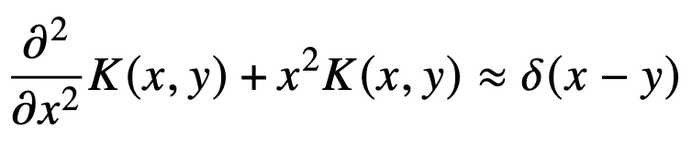
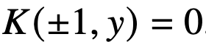
1) Finite Differences
Problem:
Equation for Green’s Function
Replace G with approximation K

Slide 8
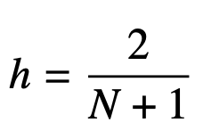
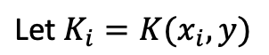
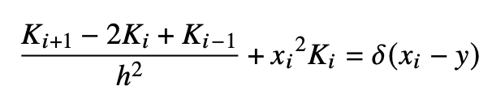
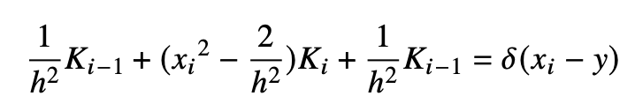

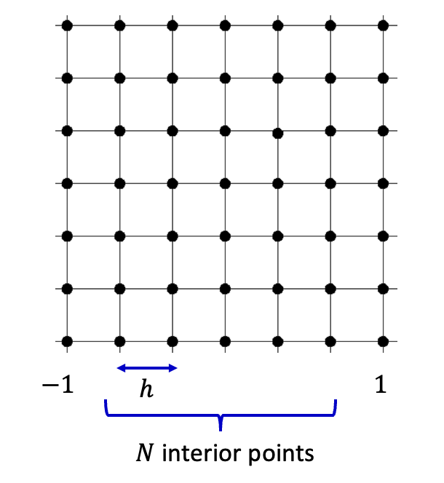
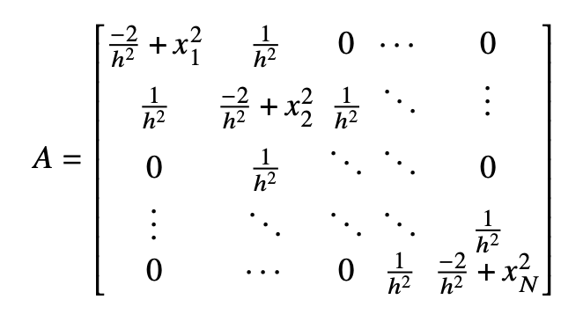
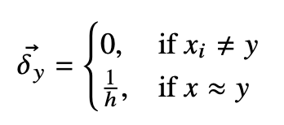
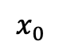
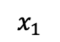
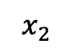
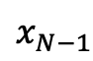
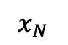
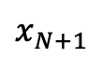
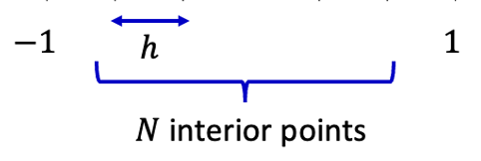
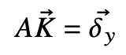
Discretising the problem
,
Represent LHS:
Represent RHS:
. . .
Use Argmin function in Julia:
Finds closest sampled point to spike
Notes:
use the "argmin" function to determine the element of the grid closest to 𝑦. This introduces an error in coarser grids, but with more computing power and a finer grid this error becomes negligible.

Slide 9
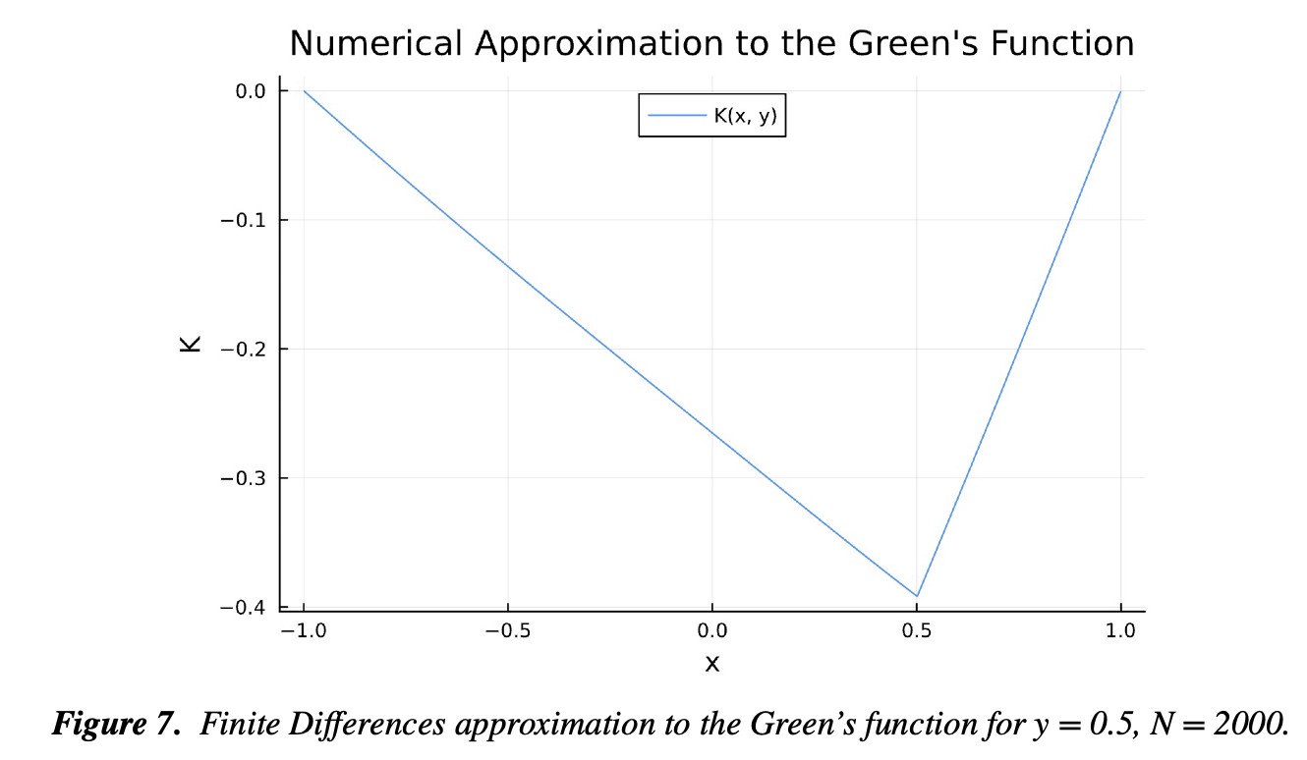
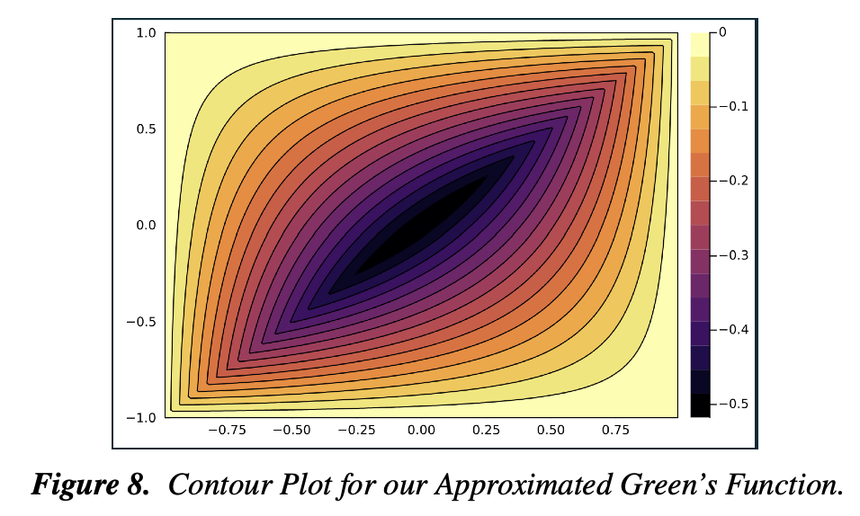
One slice (for y = 0.5)
Not quite linear!
Contour plot for all y

Slide 10
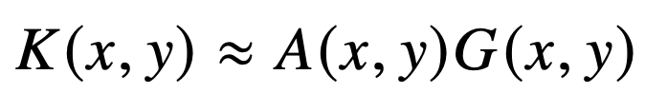
2) Multiplicative Correction Function
Known:
Numerical GF for PDE 2
Analytical GF for PDE 1
Want to find:
Bivariate Correction function

Slide 11
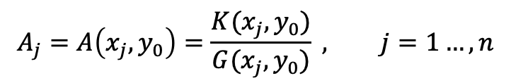

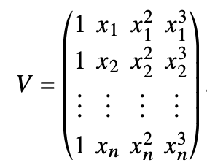
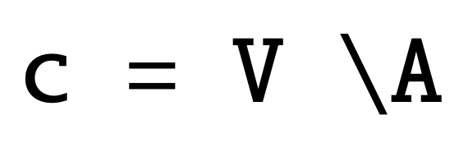
Compute discrete vector ratio:
K is piecewise by nature, so we fit 2 polynomials- one on right and one on left of spike
Vandermonde matrix:

Slide 12
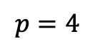
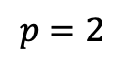





Slide 13





Discrete vector ratio:
Vandermondes for each variable:
Combine with Kroneker product:

Slide 14



Slide 15




3) Ultraspherical Spectral Method
Converges at a faster rate than polynomial

Slide 16















Ultraspherical ladder and differentiation
Original Chebyshev-T basis
diff
diff
Representation as matrices:
Where:
Where:
Stacking infinitely many basis
functions side-by-side such that
Notes:
Thinking of T as a quasi‐matrix lets us use all our usual linear‐algebra tricks

Slide 17


Building spectral operator

Slide 18



What is the Heat Equation?
The heat equation is a fundamental partial differential equation (PDE) that describes how heat distributes or diffuses through a given region over time.
Homogeneous (no heat source): Describes heat flow in an isolated system.
Inhomogeneous (with a heat source): Accounts for an external heat source, g (x, t).

Slide 19

Solving the Homogeneous 1D Heat Equation

Slide 20



Solving F

Slide 21



Solving G

Slide 22




Solving B

